Slide 1
Greedy methods: Activity selection problem
Session 12
Nikita Ananda Putri Masaling, S.Kom., M.Kom.

Slide 2
Outline materials
Session 12
Activity-selection problem
Recursive greedy algorithm
Iterative greedy algorithm
Elements of greedy strategy
Exchange argument proof technique
Huffman Code

Slide 3
Learning Outcomes
Session 12
By the end of this session, students will be able to:
LO 1: Evaluate the time and space complexity of algorithms using asymptotic notation and formal analysis methods, and prove algorithm correctness using loop invariants, induction, or exchange arguments.
LO 3: Design solutions to unfamiliar computational problems by selecting and applying appropriate strategies including Divide and Conquer, Greedy, Dynamic Programming, and Backtracking.

Slide 4
Activity selection problem
definition
The activity selection problem is a classic optimization problem that involves selecting a maximum-size subset of mutually compatible activities from a given set of activities, each with a start time and finish time.
The objective is to choose the largest possible set of activities that do not overlap in time.

Slide 5
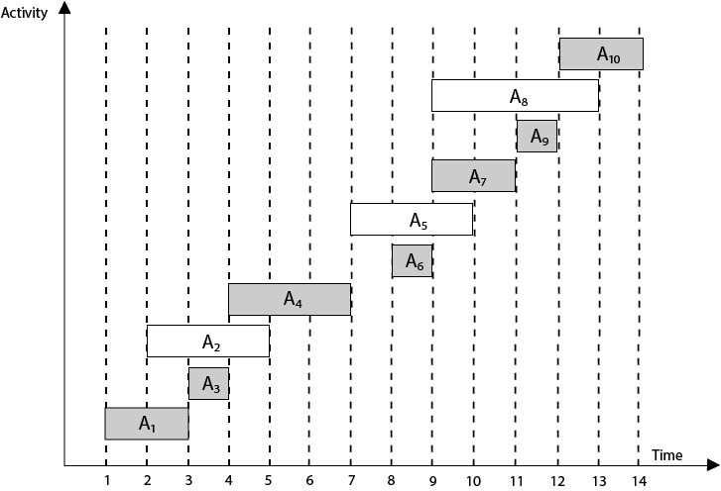
Activity selection problem
definition

Slide 6
Activity selection problem
definition
Formally, let A = {a1, a2, ..., an} be a set of n activities, where each activity ai is characterized by its start time si and finish time fi, such that 0 ≤ si < fi for all i.
The goal is to find a subset S ⊆ A, such that no two activities in S overlap in time, and |S| (the cardinality of S) is maximized.
In other words, we want to select activities in such a way that they do not conflict with each other, and we aim to find the largest possible number of non-overlapping activities.

Slide 7
Activity selection problem
definition
The activity selection problem can be solved efficiently using greedy algorithms, such as the greedy activity selection algorithm, which sorts the activities based on their finish times and selects the activities that are compatible with the previously selected activities.
The greedy approach provides an optimal solution for this problem.
We’ll develop a recursive greedy algorithm to solve the activity-selection problem.
Finally, we’ll complete the process of developing a greedy solution by converting the recursive algorithm to an iterative one.

Slide 8
Recursive greedy algorithm
Let’s see a straightforward, recursive procedure to solve the activity-selection problem.
The procedure RECURSIVE-ACTIVITY-SELECTOR on the following page takes the start and finish times of the activities, represented as arrays s and f, the index k that defines the subproblem Sk it is to solve, and the size n of the original problem.
It returns a maximum-size set of mutually compatible activities in Sk.
The procedure assumes that the n input activities are already sorted by monotonically increasing finish time.

Slide 9
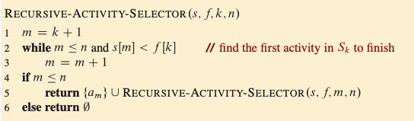
Recursive greedy algorithm

Slide 10

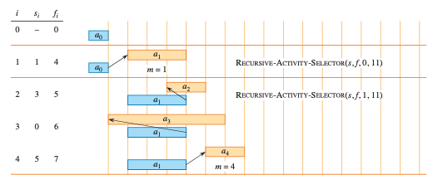
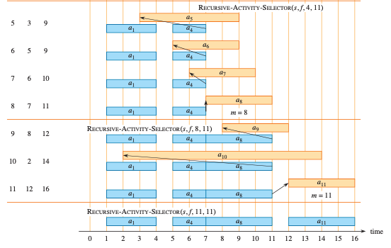
Recursive greedy algorithm

Slide 11
Recursive greedy algorithm

Slide 12
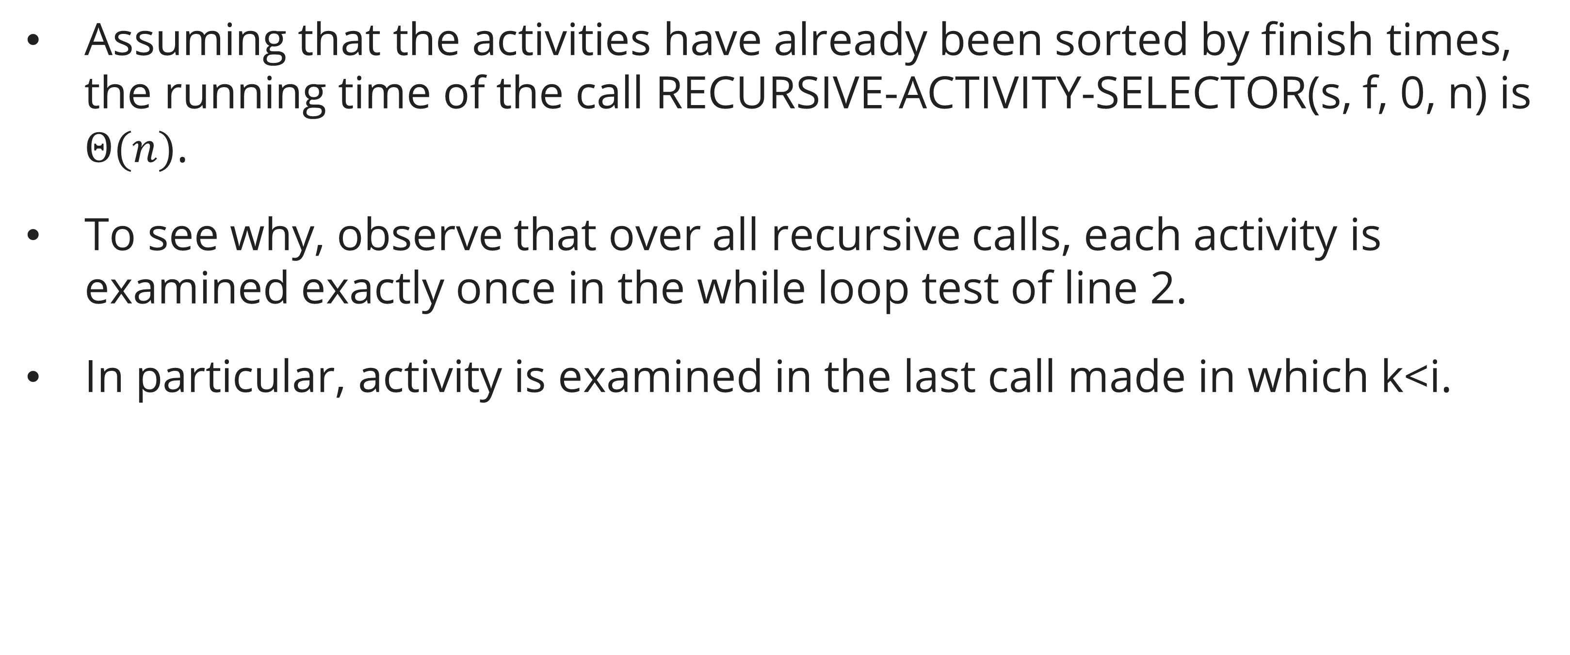
Recursive greedy algorithm
Assuming that the activities have already been sorted by finish times, the running time of the call RECURSIVE-ACTIVITY-SELECTOR(s, f, 0, n) is $Θ(n)$.
To see why, observe that over all recursive calls, each activity is examined exactly once in the while loop test of line 2.
In particular, activity is examined in the last call made in which k<i.

Slide 13
iterative greedy algorithm
The recursive procedure can be converted to an iterative one because the procedure RECURSIVE-ACTIVITY-SELECTOR is almost “tail recursive”: it ends with a recursive call to itself followed by a union operation.
It is usually a straightforward task to transform a tail-recursive procedure to an iterative form.
In fact, some compilers for certain programming languages perform this task automatically.
The procedure GREEDY-ACTIVITY-SELECTOR is an iterative version of the procedure RECURSIVE-ACTIVITY-SELECTOR.
It, too, assumes that the input activities are ordered by monotonically increasing finish time. It collects selected activities into a set and returns this set when it is done.

Slide 14
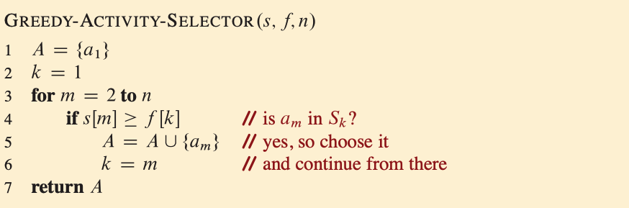
iterative greedy algorithm

Slide 15
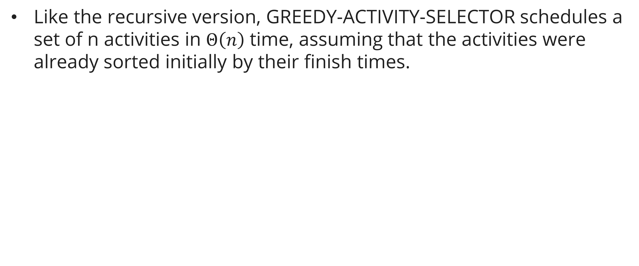
iterative greedy algorithm
Like the recursive version, GREEDY-ACTIVITY-SELECTOR schedules a set of n activities in $Θ\left(n\right)$ time, assuming that the activities were already sorted initially by their finish times.

Slide 16
Elements of greedy strategy
A greedy algorithm obtains an optimal solution to a problem by making a sequence of choices.
At each decision point, the algorithm makes the choice that seems best at the moment.
This heuristic strategy does not always produce an optimal solution, but as in the activity-selection problem, sometimes it does.
This section discusses some of the general properties of greedy methods.

Slide 17
Elements of greedy strategy
You can design greedy algorithms according to the following sequence of steps
  Cast the optimization problem as one in which you make a choice and are left with one subproblem to solve.
  Prove that there is always an optimal solution to the original problem that makes the greedy choice, so that the greedy choice is always safe.
  Demonstrate optimal substructure by showing that, having made the greedy choice, what remains is a subproblem with the property that if you combine an optimal solution to the subproblem with the greedy choice you have made, you arrive at an optimal solution to the original problem.
How can you tell whether a greedy algorithm will solve a particular optimization problem? No way works all the time, but the greedy-choice property and optimal substructure are the two key ingredients.

Slide 18
Elements of greedy strategy
Greedy choice property
The greedy-choice property states that a globally optimal solution can be reached by making locally optimal choices at each step of the algorithm.
To establish the greedy-choice property, we need to demonstrate/prove that at each step, choosing the locally optimal solution will not lead to a suboptimal or incorrect final solution.
You can usually make the greedy choice more efficiently than when you have to consider a wider set of choices.
For example, in the activity-selection problem, assuming that the activities were already sorted in monotonically increasing order by finish times, each activity needed to be examined just once.

Slide 19
Elements of greedy strategy
Optimal substructure
The optimal substructure property means that an optimal solution to a problem contains optimal solutions to its subproblems.
In the context of a greedy algorithm, optimal substructure implies that if we have an optimal solution to a subproblem, we can use this solution to construct an optimal solution to the larger problem.
By leveraging optimal substructure, we can break down the problem into smaller subproblems and solve them independently. Then, we combine these optimal subproblem solutions to obtain the overall optimal solution.
All you really need to do is argue that an optimal solution to the subproblem, combined with the greedy choice already made, yields an optimal solution to the original problem.

Slide 20
Elements of greedy strategy
To summarize, if a problem exhibits both the greedy-choice property and optimal substructure, it is a strong indication that a greedy algorithm can be developed to solve the optimization problem.
These properties allow us to make locally optimal choices and construct an optimal solution step by step.
However, it's important to note that not all problems possess these properties, and in such cases, a greedy algorithm may not be appropriate or may not guarantee an optimal solution.

Slide 21
Exchange argument proof
General Structure
To prove a greedy algorithm optimal using the exchange argument:
Assume an optimal solution O that does not match the greedy solution G.
Find the first position where they differ.
Show that swapping the element in O to match G does not decrease the objective.
Repeat until O = G. Conclude G is optimal.

Slide 22
Exchange argument proof
Example: Scheduling to Minimize Lateness
Problem: n jobs with deadlines dᵢ and processing times pᵢ; minimize maximum lateness max(Cᵢ − dᵢ).
Greedy rule: sort by earliest deadline first (EDF).
Exchange argument: any inversion (job i after j when dᵢ < dⱼ) can be fixed by swapping i and j. This reduces max lateness. Therefore EDF is optimal.

Slide 23
Concept of compression technique
How does a compression program really work?
Why can size of file be reduced without reducing its contain?
Supposed we will store letter A. Computer recognizes the letter as a character with sequence 65, then the letter is stored in harddisk as 1000001 (binary number of 65 decimal). It needs 7 binary digit to store letter A.
So, 1000001 is the codeword of A.
Data compression tries to store as minimum as possible number of binary digits.

Slide 24
Concept of compression technique
Encoding characteR
ASCII (American Standard Code for Information Interchange)
  ASCII character encoding consists 128 characters; 7 bit binary numbers; printed 95 characters and 33 command character.
ISO 8859-1 is a standard character with 8 bit, can store 256 characters.
  This standar is called as character encoding Latin-1.
UTF-8 (Unicode Transformation Format) is a standard encoding character that enable many languages as shown in the same time. Number of bit to store a character is different.
  ASCII character is stored in 1 byte (8 bit).
  Latin, Greek, Cyrillic, Armenian, Hebrew, Arabic, Syriac dan Thaana character is stored in 2 byte (16 bit).
  Other languages character is stored in 3 byte (24 bit). Character of Jawa/Bali (hanacaraka alphabetic) dan Bugis from Indonesia exist in this standard.
  In the future it is possible to store character in 4 byte.

Slide 25
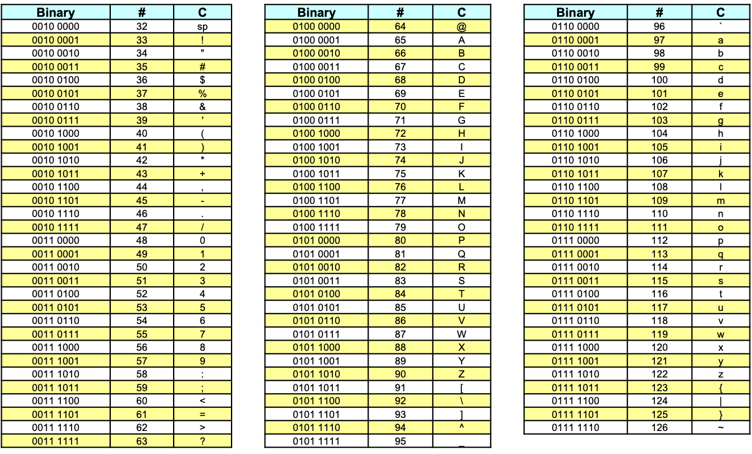
Concept of compression technique
Character table

Slide 26
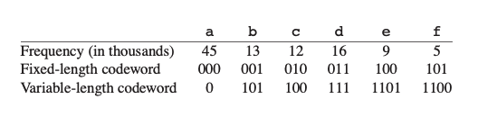
Concept of compression technique
Fixed length code vs variable length code
There are two types of codeword: Fixed-length and Variable-length.
For example, we have a data file of 100,000 characters contains only the character a-f
Fixed-length code requires (3 . 100,000) = 300,000 bits to encode the entire file.
Variable-length code requires (45 . 1 + 13 . 3 + 12 . 3 + 16 . 3 + 9 . 4 + 5 . 4) . 1,000 = 224,000 bits, a saving of ((300,000-224,000)/300,000 . 100%) = 25.33%.

Slide 27
Introduction to Huffman code
Huffman algorithm
Invented by David A. Huffman in 1951 when he studied his Ph.D at Massachusetts Institute of Technology (MIT).
He discovered a method to build binary tree based on frequency. The Binary Tree is called as Huffman Tree is foundation of data compression with ZIP format.
The technique is used as algorithm to create JPEG image and musical file format MP3.

Slide 28
Introduction to Huffman code
Prefix-free codes
E | 0
T | 11
N | 100
I | 1010
S | 1011
E | 0
T | 10
N | 100
I | 0111
S | 1010
11010010010101011
100100101010
Try to decode the code above using each table

Slide 29
Introduction to Huffman code
Prefix-free codes
No prefix of a codeword in a codeword -> prefix-free codes.
Uniquely decodable.
a prefix-free code can always achieve the optimal data compression among any character code,
  so we suffer no loss of generality by restricting our attention to prefix-free codes.
Using variable-length codeword in slide 6, we have string 100011001101 which parses uniquely as 100 . 0 . 1100 . 1101, which decodes to cafe

Slide 30
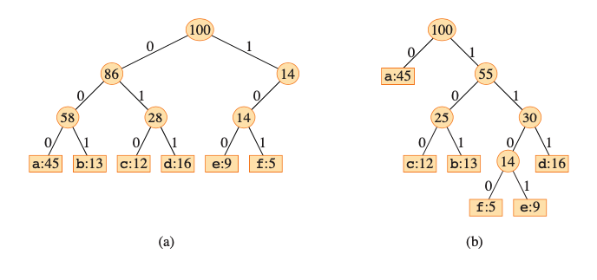
Introduction to Huffman code
Prefix-free codes
(a) is tree corresponding to the fixed-length code
(b) is tree corresponding to the optimal prefix-free code.
Note that optimal code for a file is always represented by a full binary tree!

Slide 31
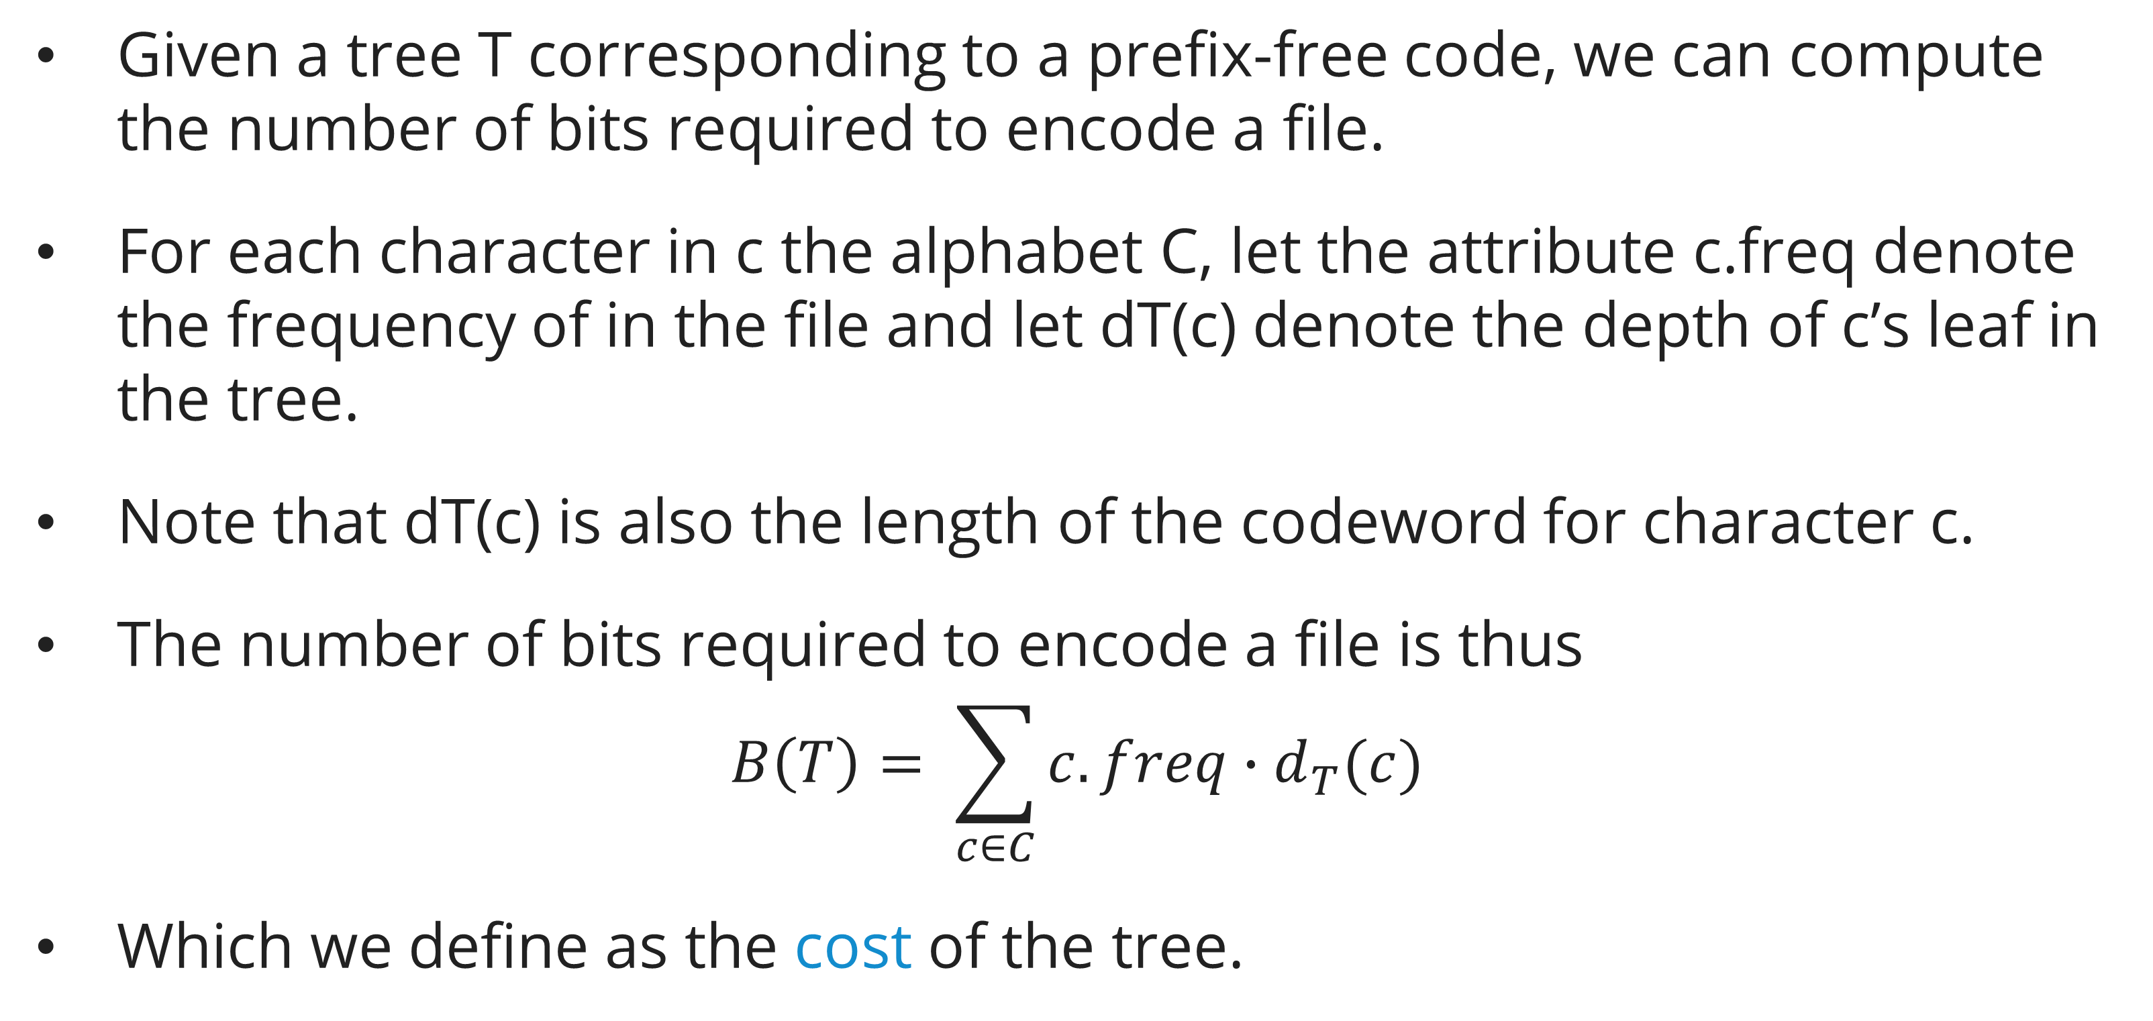
Creating a Huffman tree
Computing cost
Given a tree T corresponding to a prefix-free code, we can compute the number of bits required to encode a file.
For each character in c the alphabet C, let the attribute c.freq denote the frequency of in the file and let dT(c) denote the depth of c’s leaf in the tree.
Note that dT(c) is also the length of the codeword for character c.
The number of bits required to encode a file is thus
$$B\left(T\right)= \sum_{c∈C}{c.freq∙d_{T}(c)}$$
Which we define as the cost of the tree.

Slide 32
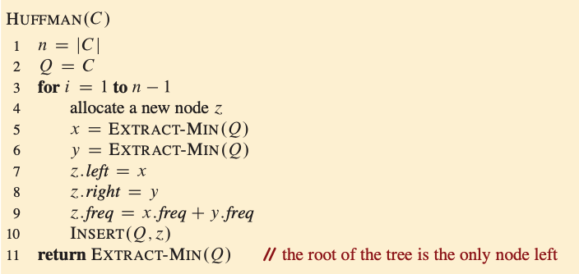
Creating a Huffman tree
Huffman procedure

Slide 33
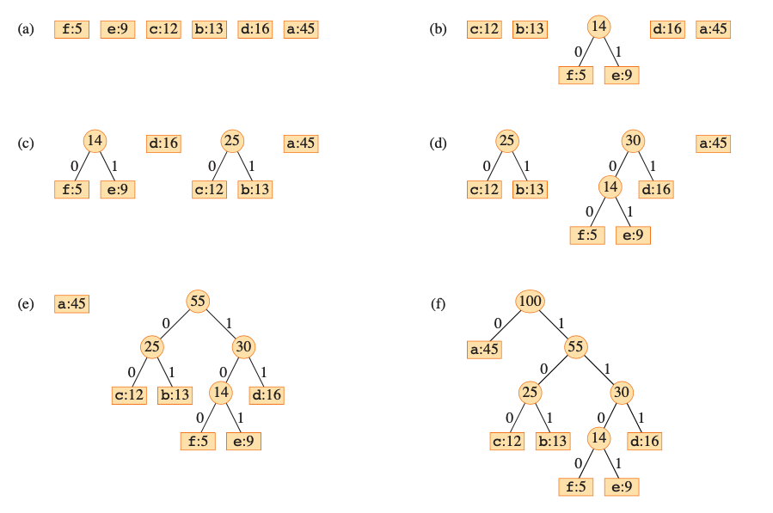
Creating a Huffman tree
Huffman procedure: example

Slide 34
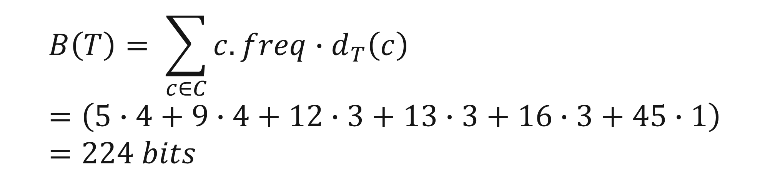
Creating Huffman Code table based on Huffman tree
f | e | c | b | d | a
5 | 9 | 12 | 13 | 16 | 45
← Frequency table
f | e | c | b | d | a
1100 | 1101 | 100 | 101 | 111 | 0
← Huffman code table
$$B\left(T\right)= \sum_{c∈C}{c.freq∙d_{T}\left(c\right)}=\left(5∙4+9∙4+12∙3+13∙3+16∙3+45∙1\right)=224 bits$$

Slide 35
Creating Huffman Code table based on Huffman tree
analysis
The running time of Huffman’s algorithm depends on how the min-priority queue Q is implemented.
Let’s assume that it’s implemented as a binary min-heap.
For a set C of n characters, the the heap initializes in O(n) time in line 2.
The for loop in lines 3-10 executes exactly n-1 times, and each heap operation runs in O(lg n) time.
Thus, the loop contributes O(n lg n) to the running time.
The total running time is then O(n lg n).

Slide 36
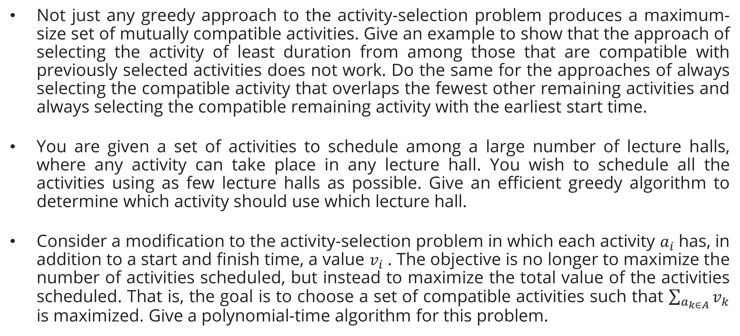
Exercises
Session 12
Not just any greedy approach to the activity-selection problem produces a maximum-size set of mutually compatible activities. Give an example to show that the approach of selecting the activity of least duration from among those that are compatible with previously selected activities does not work. Do the same for the approaches of always selecting the compatible activity that overlaps the fewest other remaining activities and always selecting the compatible remaining activity with the earliest start time.
You are given a set of activities to schedule among a large number of lecture halls, where any activity can take place in any lecture hall. You wish to schedule all the activities using as few lecture halls as possible. Give an efficient greedy algorithm to determine which activity should use which lecture hall.
Consider a modification to the activity-selection problem in which each activity $a_{i}$has, in addition to a start and finish time, a value $v_{i}$. The objective is no longer to maximize the number of activities scheduled, but instead to maximize the total value of the activities scheduled. That is, the goal is to choose a set of compatible activities such that $\sum_{a_{k∈A}}{v_{k}}$ is maximized. Give a polynomial-time algorithm for this problem.

Slide 37
Exercises
Session 12
Create Huffman code to compress:
DESIGN AND ANALYSIS OF ALGORITHMS
Calculate the bits above and compare it with the traditional fixed-length codes. (Calculate the % savings)
For uniform character distribution, the Huffman encoding will be equal to the fixed-length encoding. Why?

Slide 38
References
Session 12
Primary (Required): Cormen, T.H., Leiserson, C.E., Rivest, R.L., & Stein, C.(2022). Introduction to Algorithms, 4th Edition. MIT Press.​
Ch. 15.1 — An Activity-Selection Problem (p. 418)​
Ch. 15.2 — Elements of the Greedy Strategy (p. 426)​
Ch. 15.3 — Huffman Codes (p. 431)​
Secondary (Required): Skiena, S.S. (2020). The Algorithm Design Manual, 3rdEdition. Springer.​
Ch. 21.5 — Text Compression — Huffman Codes (p. 693) (Activity-selectionnot in Skiena; CLRS Ch. 15.1 is the primary reference.)​

